Slide 1


ModelWriter Text & Model-Synchronized Document Engineering Platform
Project Leader: Ferhat Erata (ferhat@computer.org)
Project Email: project@modelwriter.eu
Notes:
I’d like to begin by thanking you all for coming today.
My name is [Ferhat Erata] from [UNIT Information Technologies Research & Development].
I am the project leader of ModelWriter project.
Before starting the presentations, I would like to invite review chairman to make the introductory speech for today’s review.
The graphics on this slide is a mock-up that shows what was envisioned before starting off the project. This demonstrates two aspects of ModelWriter. At the RHS is the writer part and at LHS is the model part. If you look at the details, the synchronization is maintained behind the scene.
1

Slide 2
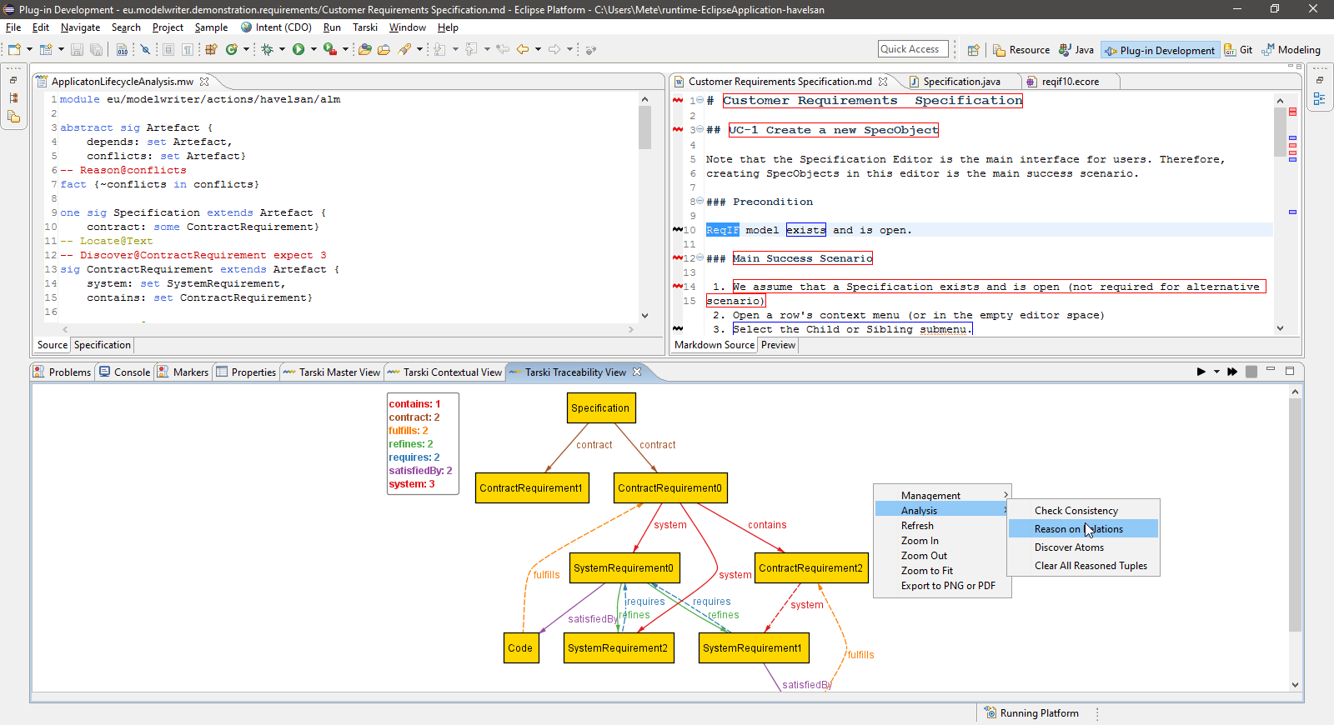
ModelWriter Text & Model-Synchronized Document Engineering Platform
Project Leader: Ferhat Erata (ferhat@computer.org)
Project Email: project@modelwriter.eu
Notes:
The latter one, this one, clearly shows that we achieved the goal of having a working User Interfaces on Eclipse platform. That was what we anticipated. In addition to that, we provide a view at the bottom to visualize the those traceability links between artefacts or part of artefacts.
2

Slide 3
1 Introduction
Ferhat Erata
UNIT, ModelWriter Project Leader
Notes:
Let me introduce the partners attends today’s meeting. I have already introduced myself.
Let’s begin with CNRS/LORIA, Prof. Claire, could you introduce yourself and your research organization…
3

Slide 4








Participants ModelWriter #1 Review
Ferhat Erata
Dr. Moharram Challenger
Hasan Emre Kirmizi
Yvan Lussaud
Etienne Juliot
Dr. Eray Tuzun
Yagup Macit
Tuğçe Yiğiter
Alan Endersoy
Dr. Emrah Kinav
Dr. Guven Köse
Omurhan Soysal
Aydin Can Polatkan
Dr. Claire Gardent
Dr. Samuel Cruz-Lara
Dr. Bikash Gyawali
Anastasia Shimorina
Dr. Geylani Kardas
Mehmet Onat
Hale Gezgen
Ersan Gürdoğan
Taskin Kızıl
Oguz Yavuz
Dr. Anne Monceaux
Notes:
Let me introduce the partners attends today’s meeting. I have already introduced myself.
Let’s begin with CNRS/LORIA, Prof. Claire, could you introduce yourself and your research organization…
I would like to specially thank Anne for hosting the meeting, to Vincent for his mentorship.
4

Slide 5
Agenda [13:00 - 17:00]
Introduction (5 mins) [13:00 - 13:05]
Overview of the project (WP5) (15 min) [13:05 - 13:20]
Industrial Use Cases (WP1) (30 min) [13:20 - 13:50]
Exploitation Related Activities (WP7) (10 mins) [13:50 - 14:00]
Technical Innovations (WP2, 3 & 4) (30 mins) [14:00 - 14:30]
User Interfaces & Integration (WP6) (10 mins) [14:30 - 14:40]
Break (20 mins) [14:40 - 15:00]
Demonstrations (60 mins) [15:00 - 16:00]
Conclusions (10 mins) [16:00 - 16:10]
Reviewers’ Private Section (30 min) [16:10 - 16:40]
Feedback Session (15min) [16:40 - 16:55]
Final Words (5 min) [16:55 - 17:00]
Notes:
We’ve planned an intense schedule for today. Presentation is divided into 5 main sections.
First I will make an overview of the project.
Second, Anne from Airbus will moderate the industrial use cases segment. Based on your feedbacks made after the first review, we made a decision to focus on the most rewarding use cases that are stemmed from the problems faced by our large industrial partners. Therefore, Airbus, Ford-Otosan and Havelsan will present their use cases. In each use case, we will describe Technical Challenges and corresponding KPIs.
Third, once you get familiar with the problem domain, we will explain the market of ModelWriter and our exploitation prospects.
Fourth, we’ll describe technical achievements attained for each technical work package, which means will focus on innovations in this section. What we accomplished beyond the SotA and innovations in tackling the challenges. We will try to convince you that ModelWriter is an effective remedy for this set of problems.
Finally, we will demonstrate what we achieved in the industrial use cases. We will make three demonstrations for Airbus, Havelsan and Ford Otosan.

Slide 6
2 Overview of the Project
Ferhat Erata
UNIT, ModelWriter Project Leader

Slide 7
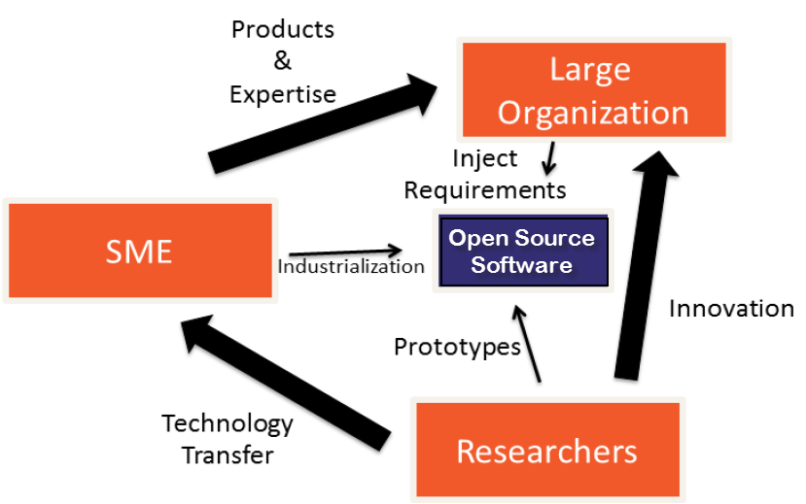



Industrialization Triangle in ModelWriter Open Source Software (year #1)
Industrial Use Cases
Success Stories
Long Term Agreements
ModelWriter
New Product & Services
Commercialization
Open Source Software
Standardization
New Standard or Standard Extension
Publications, Open Source Software
Notes:
If you look at this Figure, you will see ModeWriter’s industrialization triangle.
ModelWriter is an Open-Source Software Platform and partners positioned around them.
We transfer the knowledge in university to industry which they develope theory and prototypes.
by means of combining the expertise of SMEs of the consortium (in our case, eclipse)
In this triangle, Large Organizations (most of their dominant core business is not developing software related services) provides the industrial expertise and define requirements
SMEs commercialize the solutions in the market as products.
We initially positioned on the triangle as shown here.

Slide 8

Industrialization Triangle in ModelWriter Open Source Software (year #2)
Industrial Use Cases
Success Stories
Long Term Agreements
ModelWriter
New Product & Services
Commercialization
Open Source Software
Standardization
New Standard or Standard Extension
Publications, Open Source Software
Notes:
After withdrawal of Belgian Consortium, we repositioned ourselves to be more effective and efficient.
KocSistem and Hisbim become tool providers. UNIT started a research program.
FordOtosan joined in the consortium as industrial use case provider.
We reduced the number of industrial cases that we’ve focused on to three domain, which are ALM and PLM from aerospace. automotive and military software business.

Slide 9
ModelWriter Today’s Knowledge Capture
Knowledge Capture with Word Processors
Document-centric,
Knowledge Capture with Modelling Tools
Model-centric, Structural and formal
Seamless Knowledge Capture with ModelWriter
ModelWriter as integrated product
Technical Documents
Natural Language
Modelling and Model Reasoning tools (= “Model” part),
and keeps both views seamlessly synchronized with each other.
Requirements, Specifications Architectural Design Documents, 3D Design Models …
Very Informal ones (mind maps, text tables, spreadsheets)
Formal ones (UML, SysML, EMF, BPMN …)
Text-based
Semantic Parser & Annotator (= “Writer” part)
Notes:
Let me introduce your three pillar, motivation, three main functionality of the project.

Slide 10
ModelWriter bi-directional Knowledge Capture tool

Slide 11
What is the problem?

Slide 12
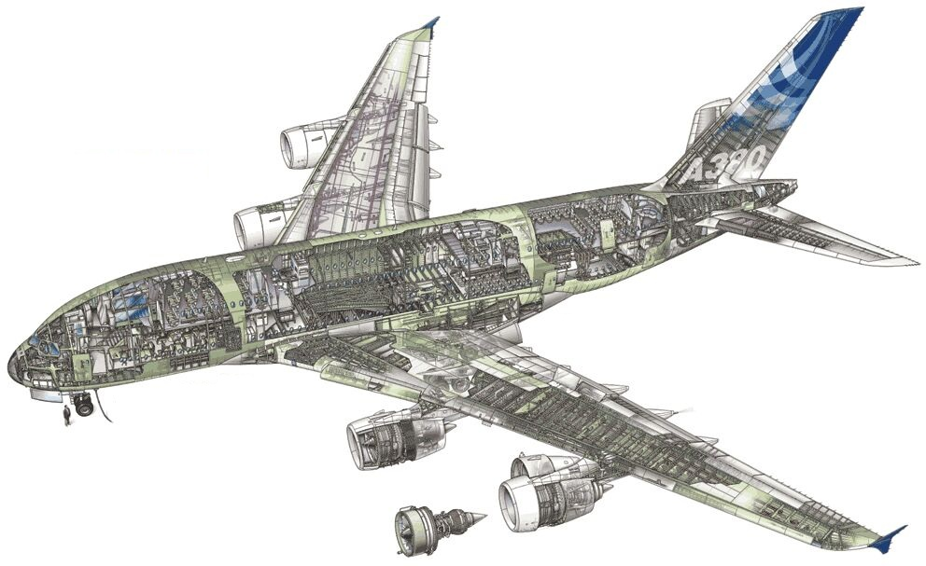
Industrial Use Case in Airbus
Synchronization of regulation documentation with a design rule repository

Slide 13
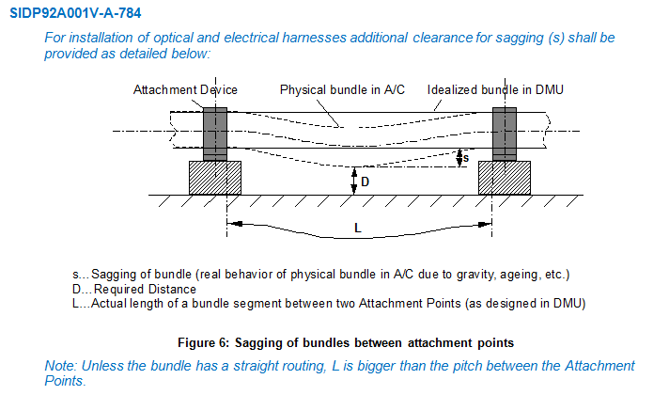
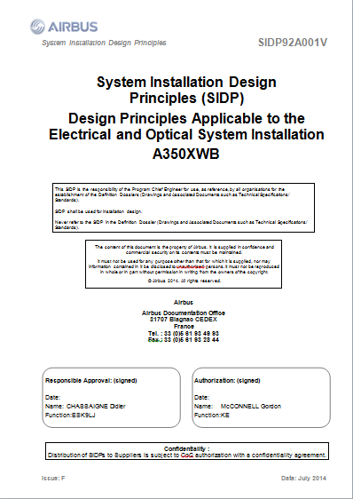
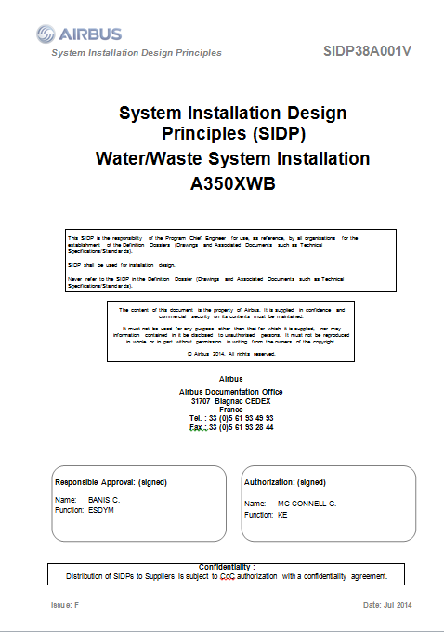
SIDP: System Installation Design Principles

Slide 14
Component Ontology and Rules
Objectives:
Manage rules/design principles and improve traceability
Automate identification of design conflicts against rules
ObjectProperties
Component
Assembly
“Structural_Element”
subClassOf
“Bracket”
Physical component
Attachment device
“Fastener”
“Pclamp”
Clamp
AnnotationProperties
Rdfs:label
“Assembly”
Skos:prefLabel
P-Clamp
“P-clamp NSA5516 can be fixed on X with Y”
P-Clamp NSA5516
“Physical component”
“Standard reference”

Slide 15
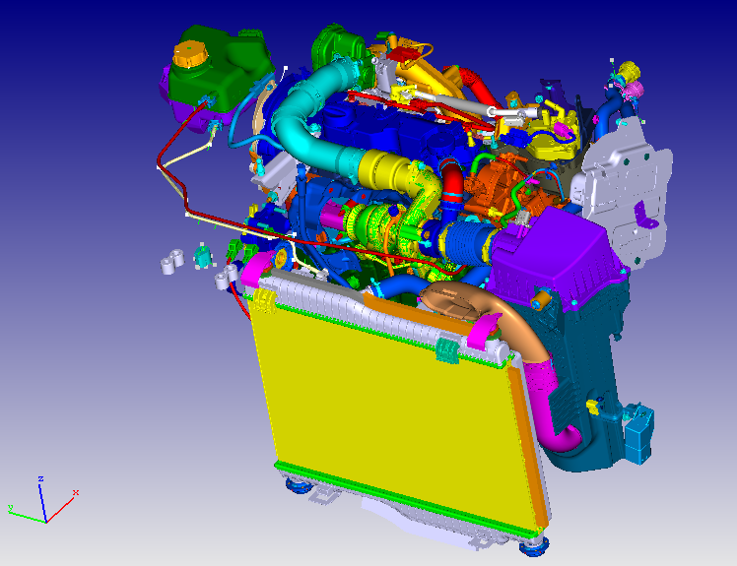
Industrial Use Case in Ford Otosan
Synchronization of Design Specifications with Computer Aided Design Data in Product Lifecycle Management

Slide 16
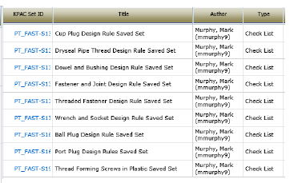
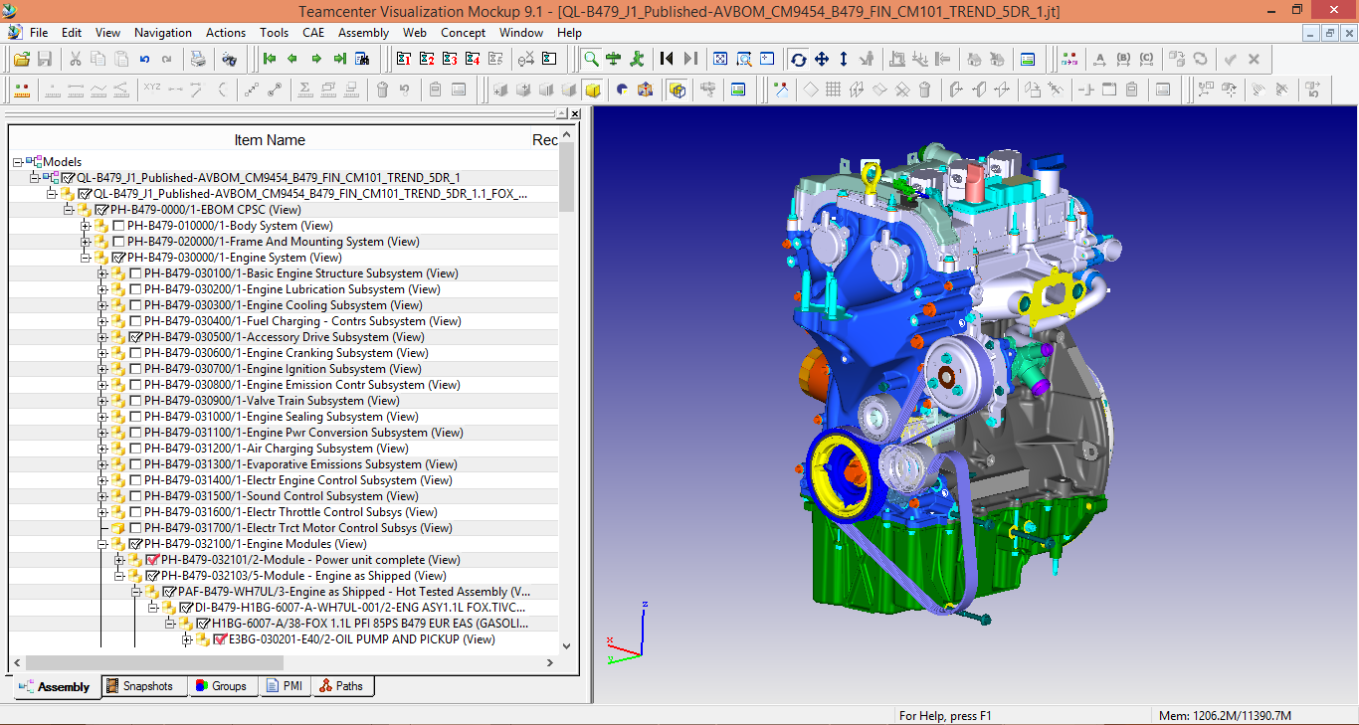
BOM and Design Specifications
“Design Rules”
“Bill of Material Data”
“Computer-aided Design Data”
Notes:
`

Slide 17
Industrial Use Case in Havelsan
Integration with Application Lifecycle Management to ensure reliability and consistency in the system under development.

Slide 18
Automated Analysis of Dynamically Configured Traceability Semantics
“Traceability Rules to define traceability semantics”
Artefacts or part of artefacts
“Various Traceability Analysis might be performed”
Notes:
SIDP is used (under Non Disclosure agreement) as a use case

Slide 19
Level of Collaboration within ModelWriter International Collaboration
Yvan Lussard
Ferhat Erata
Open Source Software (Eclipse Public License)
Eclipse Mylyn Intent Project Lead
ITEA2 ModelWriter Project Lead
AIRBUS SIDP Documentation
Dr. Claire Gardent
Life-cycle Traceability
Dr. Anne Monceaux
ITEA3-ASSUME Project
Dr. Eray Tuzun
Dr. Geylani Kardaş
Dr. Emrah Kınav

Slide 20


Level of Collaboration within ModelWriter International Collaboration
Prof. Hans Vangheluwe (Chair)
Dr. Anne Monceaux (MC)
MPM4CPS
Ferhat Erata (MC)
University of Antwerp (Grant Holder)
Modeling, Design & Simulation Lab.
Multi-Paradigm Modeling, Formalism Transformation,
Cyber-physical Systems
Software Engineering Research Lab
IC1404 Cost Action for Multi-Paradigm Modeling for Cyber-physical Systems

Slide 21
ModelWriter Activities in the First Year https://github.com/modelwriter/workshops
The 1st International ModelWriter Workshop in Izmir, Turkey (Jan 15-17, 2015) [M4]
The 2nd International ModelWriter Workshop in Brussels, Belgium (Apr 30, 2015) [M7]
The 3rd International ModelWriter Workshop in Toulouse, France (Jun 22-23, 2015) [M10]
The 4th International ModelWriter Workshop in Brussels, Belgium (Sep 23-24, 2015) [M12]
The 1st International Eureka Project Exhibition in Berlin, Germany (Mar 10-11, 2015) [M6]
The 5th International ModelWriter Workshop in Ludwigsburg, Germany (Nov 2-5, 2015) [M16]
Project Kick-off in Istanbul, Turkey (Nov 08, 2014) [M1]
Initial Architectural Design, Indutrial Use Cases, Technical WP discussions
Collaboration Infrastructure
Exploitation: Havelsan’s participation
Consolidated User Requirements & Review
Software Requirements Review & Architecture
Rehearsal & Review
Integration of software components
Notes:
1.
2.
3.
4.
5.

Slide 22
ModelWriter Activities in the Second Year https://github.com/modelwriter/workshops
Product Owner Review Meeting
The 6th International ModelWriter Workshop in Paris, France (Feb 15-16, 2016)
ModelWriter Poster Presentation SAT/SMT/AR Summer School 2016
ICT Cost Action - MPM4CPS WG meeting at Vienna, Austria, on the 15-16 April, 2016
The 7th International ModelWriter Technical Workshop in Toulouse, France (6 June 2016)
The 7th Int’l ModelWriter Brainstorming Session in Toulouse, France at Airbus (9 June 2016)
The 7th Int’l ModelWriter Coordination Meeting in Toulouse, France at Airbus (10 June 2016)
Participation in International Joint Conference on Automated Reasoning (IJCAR) 2016
ModelWriter is positioned on the Working Groups of this Cost Action
Future of ModelWriter is discussed
Poster Presentation
Notes:
1.
2.
3.
4.
5.

Slide 23
ModelWriter Activities in the Second Year https://github.com/modelwriter/workshops
Verification Technology, Systems & Applications (VTSA) Summer School (Aug 29- Sept 02, 2016)
ICT Cost Action - MPM4CPS WG meeting at Gdansk, Poland (Sep 13-16, 2016)
A paper is submitted to ACM Applied Computing Symposium and under review.
The 8th International ModelWriter Technical Workshop in Toulouse, France (13 June 2016)
ICT Cost Action - MPM4CPS WG meeting at Malaga, Spain (Nov 24-25, 2016)
Participation in Workshop on Software Correctness and Reliability (Oct 7-8 2016)
Notes:
1.
2.
3.
4.
5.

Slide 24
ModelWriter Work Packages & Technical Innovations
WP1 Industrial Use Cases and Requirements (AIRBUS)
WP3 (UNIT)
WP4 (MANTIS)
WP6 (OBEO)
WP2 (LORIA)
Semantic Parser
Bi-directional synchronization mechanism between texts and models
A federated Knowledge Base and its API
A complete “ModelWriter” tool integrating of all these in a consistent way
Synchronization mechanism between texts/models & knowledge base
bi-directional transformation between text and formal knowledge representation
User Interfaces
Consistency checker plug-in for consistency
Configuration & Traceability Components
Document Generation
WP5 Project Management (UNIT)
WP7 Standardization, Dissemination and Exploitation (OBEO)

Slide 25
ModelWriter Technological components & interactions

Slide 26

ModelWriter Conceptual Architecture
Editor
Documents
(doc, docx, odt,textile,etc)
Text
Connectors
Text
Semantic
Module
KB
Model
Models Connectors
Model Integration
Module
Model
Models
Notes:
Simplified version of actual architecture, there is a striking resemblance between planned and actual ones which means logical decomposition of project based on functions corresponds the real architecture.

Slide 27
Thank you for your attention We value your opinion and questions.

